Slide 1

Electrical
Team: Big Gains B-)
Debby Lin
Ebi Mir-Mohammadsadeghi
Harsh Rajoria

Slide 2
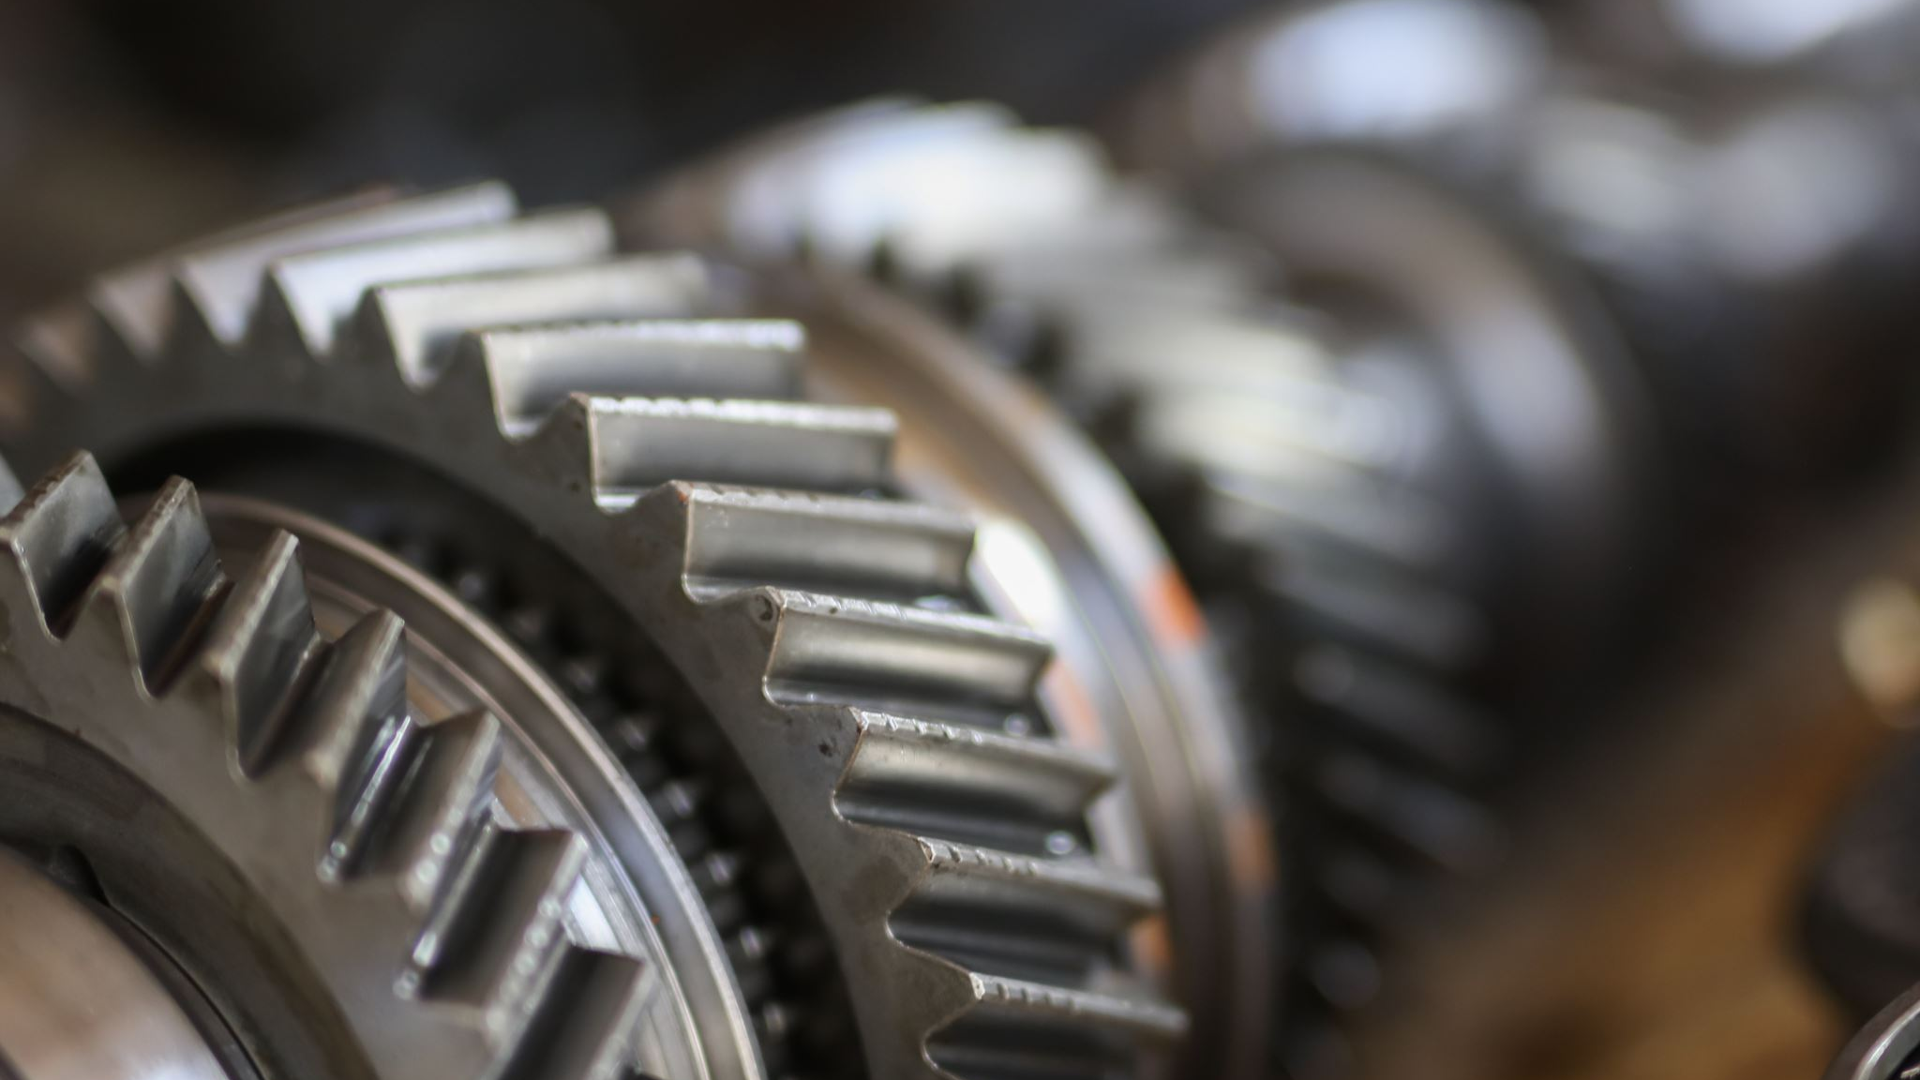
Maxon Motor

Slide 3
Planetary Gearhead (optional)

Slide 4
Optical Encoder

Slide 5
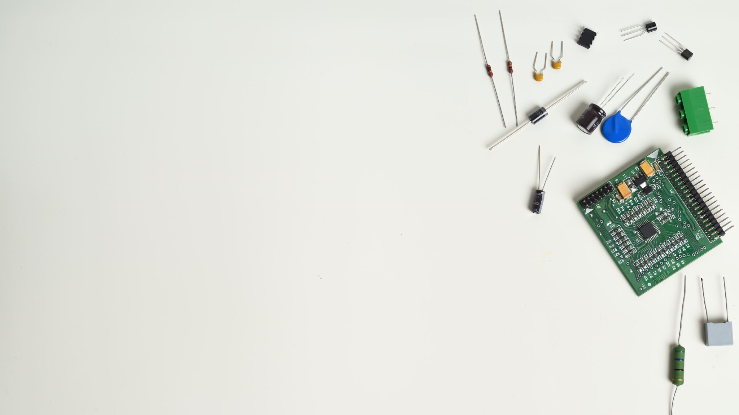
PCB

Slide 6
CAD Model

Slide 7
Circuit Board Housing

Slide 8
Design Driver CCTs???
Idk what this means

Slide 9
Simulate

Slide 10
Develop Linear Models

